Slide 1
Case Study: Classification
Machine Learning

Slide 2
Course Outline
Assignments are submitted at the same date as the next assignment comes out
Wk | Lecture 1 | Lecture 2 | Individual Assignment | Project Assignment
1 | Case Study: Regression | Case Study: Classification | A1: Car Price Prediction
2 | Batch Gradient Descent | Stochastic / Mini-Batch Gradient Descent
3 | Regularization | Binary Logistic Regression | A2: TBD
4 | Multinomial Logistic Regression | Gaussian Naive Bayes
5 | Multinomial Naive Bayes | K-Nearest Neighbors | A3: TBD
6 | Support Vector Machine | Support Vector Machine II
7 | No class | Midterm Exam |  | Phase 1: Reading paper round 1 (KDD)
8 | Decision Tree | Bagging / Random Forests |  | Phase 1: Reading paper round 2 (KDD)
9 | Ada Boosting / Gradient Boosting | K-Means Clustering |  | Phase 2: Proposal - Paper writing (Intro, Related Work, Method)
10 | Gaussian Mixture | Principal Component Analysis
11 | PyTorch Linear Regression | Project Proposal Presentation |  | Phase 3: Experiment - Paper writing (Intro, Related Work, Method, Results)
12 | PyTorch Logistic Regression | Convolutional Neural Network
13 | Recurrent Neural Network | Reinforcement Learning
14 | Q-learning | Project Progress Presentation |  | Phase 4: Conclusion - Paper writing (Abstract, Intro, Related Work, Method, Results, Discussion, Conclusion)
15 | No class | Final Exam
16 | No class | Final Project Presentation

Slide 3
Background - Classification
Predict cancer or no cancer using sizes?
Predict positive or negative given a sentence?
Predict car brands using images?
Notice all the labels here are categorical (discrete) values?
Classification is a supervised algorithm to predict categorical (discrete) values
Labels must be categorical; features can be categorical or continuous
Labels can be binary (two class) or multiclass
Supervised - has both features and labels; Unsupervised - only has features

Slide 4
Big picture of ML
Remember: Splitting > Imputation > Scaling
Step 2 to 5 - can be done iteratively and order may swap, it’s ok
1. Load data -> 2. Exploratory Data Analysis -> 3. Feature engineering -> 4. Feature selection -> 5. Preprocessing
CSV, JSON, Database
Renaming
Label encoding
Train / dev / test set
Check class imbalance
Countplot
Distribution plot
Boxplot
Scatter plot
Correlation Matrix
Predictive Power Score
Dimensionality reduction
Feature splitting (e.g., date)
Creating features (e.g., some equation)
Select your X (features) and y (target)
In ML, it’s better to choose X
In DL, we usually just input all features
Null values
Outliers
Fix class imbalance (up-/down-sampling
Typos / Entry errors / Duplicates / IDs
Scaling (min-max; standardize)
6. Model selection -> 7. Testing -> 8. Analysis -> 9. Inference -> 10. Deployment
Supervised
Regression
Classification
Unsupervised
Clustering
Dimensionality reduction
Reinforcement
PPO
Q-learning
Apply your best model on your test set
Analyze your model, e.g., feature importance
Apply your best model on some unseen data, and see whether it makes sense
HTML/CSS/JS
TOOLS
Python, R - programming tool
NumPy (matrix manipulation), Pandas (Excel-like), Matplotlib/Seaborn (visualization), Sklearn (machine learning), PyTorch (deep learning), Huggingface (models)
Tableau, Power BI - Business Intelligence (BI) tools
Microsoft Azure, Rapidminer, Weka - data science and machine learning tools
SPSS, SAS, JASP - statistical tool
Flask
Django
FastAPI
Docker
METRIC
Regression (r², MSE)
Classification (recall, precision, f1)
Clustering (inertia)
Dimensionality reduction (mean squared distance between the original data and the reconstructed data)
Reinforcement learning (cumulative rewards)
Overfitting
Underfitting
MLFlow
Wandb
Tensorboard
TOP VENUES
ML (KDD)
DL (ICML, NIPS, ICMR)
NLP (ACL, EMNLP)
CV (CVPR, ICCV)
Cross-validation
With/Without Sampling
Grid search

Slide 5
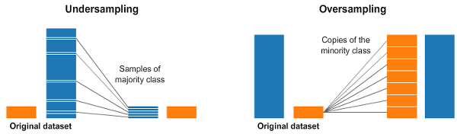
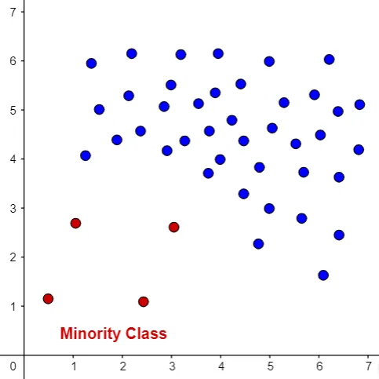
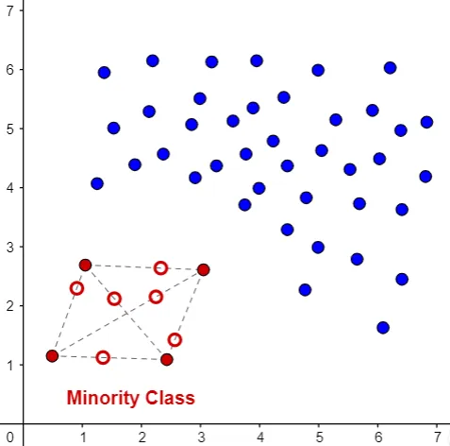
Class imbalance
In classification, it’s important to check the class imbalance
For example, if you want to predict cat or dog, but you have 100 images of cat, but 1000 images of dogs
Ways to deal with class imbalance
Sample randomly 100 images of dogs (downsampling) - loss of information
Randomly augment 900 more images of cat (upsampling) - risky info
Caution!: should only apply to your training set, NOT testing set, otherwise it causes data leakage
Penalize Algorithms - increase the cost of classification mistakes on the minority SVC(class_weight='balanced') - not all can do
Further, two types of sampling methods:
Offline - treat sampling as preprocessing step
Online - during the epoch, on the fly - avoid leakage for upsampling
If class imbalance exists, you MUST not use “accuracy”, use recall / precision / f1-score instead
Upsampling

Slide 6
Class imbalance - Offline upsampling with SMOTE
#first upsample / downsample
smote = SMOTE(random_state = 11)
X_train, y_train = smote.fit_resample(X_train, y_train)
#then do scaling + modeling
pipeline = Pipeline(steps = [['scaler', MinMaxScaler()], ['classifier', LogisticRegression(random_state=11, max_iter=1000)]])
param_grid = ....
kfold = ....
grid_search = GridSearchCV(estimator=pipeline, param_grid=param_grid, scoring='roc_auc', cv=kfold, n_jobs=-1)

Slide 7
Class imbalance - Online upsampling with SMOTE
#put smote as pipeline
pipeline = imbpipeline(steps = [['smote', SMOTE(random_state=11)], ['scaler', MinMaxScaler()], ['classifier', LogisticRegression(random_state=11, max_iter=1000)]])
param_grid = ....
kfold = ....
grid_search = GridSearchCV(estimator=pipeline, param_grid=param_grid, scoring='roc_auc', cv=kfold, n_jobs=-1)

Slide 8
Class imbalance - Which one is better upsampling method?
You can try! But in short, online method.
The offline method, when used together with cross-validation, MIGHT create inaccurate cross-validation scores. The reason is because your validation set of each fold may leak to training set of each fold, inside the cross validation, where the leakage happens when you do upsampling during preprocessing
The online method, will not leak the validation set of each fold into the training set of each fold
Note 1: For downsampling method, both are okay, not one is better than another. Just like my jupyter notebook.
Note 2: One last note, for upsampling / data augmentation, you should only do it on the training set, NEVER touch the testing set.

Slide 9
Class imbalance - replacement or without replacement
Sample with replacement - two samples may overlap with one another
Pros: two samples are independent because they are randomly picked
Cons: you do not exhaust all your data
Sample without replacement - picking samples such that all observations are exhausted
Pros: exhaust all your data
Cons: you create co-variances between samples, i.e., the first sample affects the second sample, which is not desired
Note: when your data is “HUGE”, both of them are very similar….
Note: I cannot tell you which one is better, but you need to beware of the pros and cons and use it appropriately

Slide 10
Classification metrics
Given:
y = [0, 0, 0, 1, 1, 1, 1, 1, 1, 1, 1]
ypred = [1, 0, 1, 1, 1, 0, 1, 1, 1, 1, 1]
accuracy = (TP + TN) / (TP + FP + FN + TN)
accuracy = (7 + 1) / (7 + 2 + 1 + 1) = 8 / 11 = 72%
Bad for imbalance y
recall = TP / (TP + FN)
recall = (7) / (7 + 1) = 7 / 8 = 87.5%
Good for minimizing FN, e.g., cancer
Confusion Matrix
Actual
P N
P 7 2
Predict
N 1 1
precision = TP / (TP + FP)
precision = (7) / (7 + 2) = 7 / 9 = 77%
Good for minimizing FP, e.g., search engine
f1 = 2 * ( (recall * precision) / (precision + recall) )
f1 = 2 * ( (87.5 * 77) / (87.5 + 77) ) = 81.9%
Balance
We called 7 as True Positive, 2 as False Positive, 1 as False Negative, and the bottom right one as True Negative

